Slide 1

Addressing the Challenges of Modern Society
This presentation explores the critical challenges facing modern societies and the proposed solutions to address them. From cybersecurity threats to climate change and global health issues, we will delve into the key problems and the integrated approaches required for effective mitigation and resolution. Through global cooperation and innovative strategies, we can work towards a more secure, sustainable, and resilient future for all.
sw

Slide 2
1.Cybersecurity threats refer to malicious activities that target information systems, infrastructures, and data. These threats can come from hackers, viruses, malware, and other cyber-attacks.
2Climate change refers to long-term shifts in temperatures and weather patterns, primarily due to human activities such as burning fossil fuels, deforestation, and industrial processes.
3. Global health issues encompass a wide range of health challenges that affect populations worldwide, including pandemics, infectious diseases, malnutrition, and lack of access to healthcare.

Slide 3
Addressing these challenges requires integrated approaches combining technological innovation, policy-making, education, and community engagement.
Global cooperation allows sharing resources and best practices, leading to coordinated responses.
Innovative strategies, such as new clean energy technologies and effective cybersecurity tools, are vital. Through these efforts, we can work towards a more secure, sustainable, and resilient future for all.

Slide 4

Cybersecurity Challenges and Solutions
1
Data Breaches
Increasing incidents of data breaches pose a threat to sensitive information, requiring robust encryption protocols and regularly updated security measures.
2
Phishing Attacks
Phishing attacks target individuals and organizations, leading to data theft and financial losses, necessitating enhanced cybersecurity awareness programs.
3
Ransomware Attacks
Ransomware attacks encrypt data and demand ransom payments for decryption, disrupting operations, which can be mitigated through regular data backups and anti-ransomware tools.

Slide 5
4.IoT Vulnerabilities:
Challenge: Internet of Things (IoT) devices lack robust security measures, making them vulnerable to cyber-attacks.
Solution: Implement IoT security protocols and firmware updates to address vulnerabilities and mitigate IoT-related risks.
5.Supply Chain Attacks:
Challenge: Supply chain attacks exploit vulnerabilities in third-party vendors or suppliers to compromise the target organization's security.
Solution: Conduct thorough risk assessments of supply chain partners and establish stringent security standards for vendor management.
6.Social Engineering:
Challenge: Social engineering tactics manipulate individuals into divulging sensitive information or performing unauthorized actions.
Solution: Provide regular training on social engineering awareness and establish clear protocols for verifying requests.
7.Compliance and Regulatory Challenges:
Challenge: Compliance with evolving cybersecurity regulations and standards poses operational and legal challenges for organizations.
Solution: Implement robust compliance frameworks, conduct regular audits, and stay updated on regulatory requirements to ensure adherence.

Slide 6

Addressing Climate Change Challenges
1
Extreme Weather Events
Increasing frequency and intensity of extreme weather events, such as storms, floods, and heatwaves, require disaster preparedness plans, resilient infrastructure, and early warning systems.
2
Rising Sea Levels
Rising sea levels threaten coastal communities and ecosystems, necessitating the implementation of coastal protection measures, mangrove restoration, and sustainable coastal development.
3
Biodiversity Loss
Accelerated loss of biodiversity due to habitat destruction and climate change can be addressed through protected areas, sustainable land use practices, and biodiversity conservation initiatives.

Slide 7
5.Food Security:
Challenge: Climate change impacts agricultural productivity and food security.
Solution: Invest in climate-resilient agriculture, promote crop diversity, and enhance water management practices.
6.Health Risks:
Challenge: Increased health risks from heat stress, vector-borne diseases, and air pollution.
Solution: Strengthen public health systems, implement heat action plans, and reduce emissions to improve air quality.
7.Water Scarcity:
Challenge: Growing water scarcity due to changing precipitation patterns and increased demand.
Solution: Implement water conservation strategies, improve water efficiency in agriculture, and invest in water storage infrastructure.
8.Ocean Acidification:
Challenge: Acidification of oceans threatening marine ecosystems and fisheries.
Solution: Reduce carbon emissions, promote sustainable fishing practices, and protect marine biodiversity hotspots.
9.Displacement and Migration:
Challenge: Climate-induced displacement and migration of communities.
Solution: Implement climate-resilient urban planning, support climate refugees, and enhance international cooperation on migration issues.
10.Energy Transition:
Challenge: Transitioning to renewable energy sources and reducing reliance on fossil fuels.
Solution: Invest in clean energy technologies, promote energy efficiency measures, and phase out subsidies for fossil fuels.
11.Policy and Governance:
Challenge: Policy gaps and governance challenges in addressing climate change at local, national, and global levels.
Solution: Strengthen climate governance frameworks, enhance international climate agreements, and integrate climate considerations into all policy sectors.

Slide 8
Tackling Global Health Challenges
Emerging Infectious Diseases
Antimicrobial Resistance
Non-communicable Diseases
Increasing resistance of pathogens to antimicrobial drugs can be addressed through antimicrobial stewardship programs, rational use of antibiotics, and the development of new antibiotics and alternative treatments.
Rapid emergence and spread of new infectious diseases, such as COVID-19, require strengthened global health surveillance, investment in vaccine research and development, and improved healthcare infrastructure.
Rising prevalence of non-communicable diseases, such as diabetes and cardiovascular diseases, can be mitigated through the promotion of healthy lifestyles, preventive healthcare strategies, and strengthened primary healthcare systems.

Slide 9
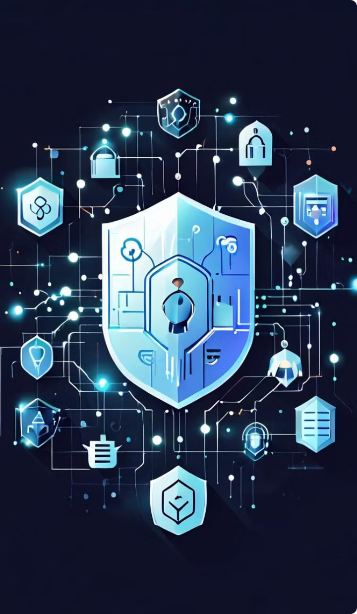
Strengthening Cybersecurity Resilience
Identity Protection
Strengthening authentication methods, such as multi-factor authentication and biometric verification, can help prevent unauthorized access and identity theft.
Insider Threat Mitigation
Implementing user behavior analytics and access controls can help detect and mitigate insider threats proactively.
Supply Chain Security
Conducting thorough risk assessments of supply chain partners and establishing stringent security standards can help address supply chain attacks.
Social Engineering Awareness
Providing regular training on social engineering awareness and establishing clear protocols for verifying requests can help mitigate these threats.

Slide 10




Adapting to Climate Change Impacts
Coastal Protection
Implementing coastal protection measures, such as seawalls, breakwaters, and living shorelines, can help safeguard coastal communities from the impacts of rising sea levels.
Ecosystem Restoration
Restoring and protecting natural ecosystems, like mangrove forests and wetlands, can enhance coastal resilience and support biodiversity conservation.
Sustainable Agriculture
Promoting climate-resilient agricultural practices, such as crop diversification and improved water management, can help address the challenges of food security and water scarcity.

Slide 11

Strengthening Global Health Security
Emerging Infectious Diseases
Strengthen global health surveillance, invest in vaccine research and development, and improve healthcare infrastructure.
Antimicrobial Resistance
Implement antimicrobial stewardship programs, promote rational use of antibiotics, and develop new antibiotics and alternative treatments.
Non-communicable Diseases
Promote healthy lifestyles, implement preventive healthcare strategies, and strengthen primary healthcare systems.

Slide 12
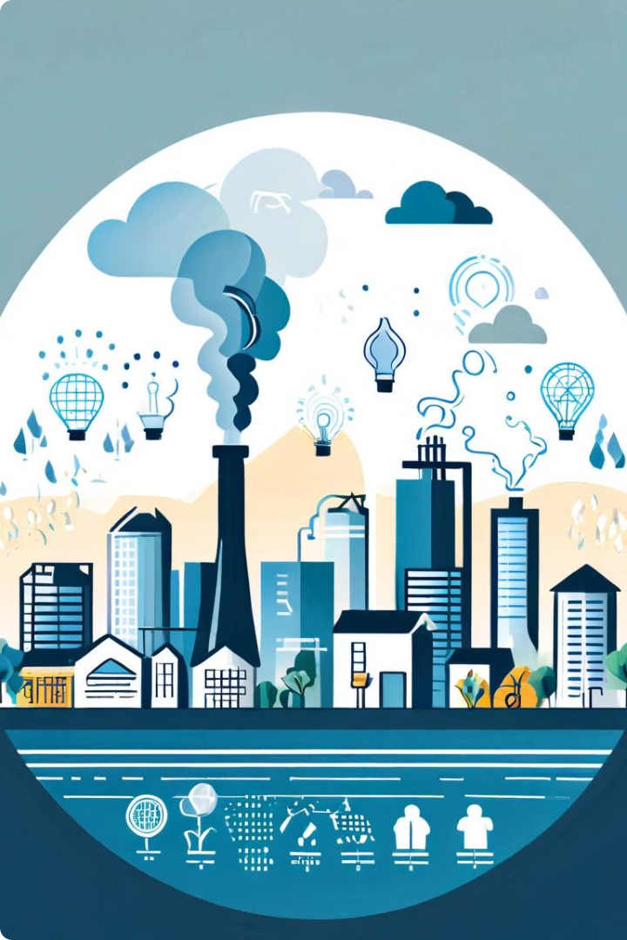
Addressing Environmental Health Risks
Environmental Pollution
Implementing environmental health regulations, promoting clean air and water initiatives, and mitigating environmental health risks can help address the health impacts of pollution.
Climate Change Impacts
Strengthening public health systems, implementing heat action plans, and reducing emissions to improve air quality can help mitigate the health risks posed by climate change.
Healthcare Access
Expanding telemedicine services, deploying mobile health units, and training community health workers can help improve healthcare access in remote and underserved areas.

Slide 13
Fostering Global Cooperation
Pandemic Preparedness
Climate Change Governance
Cybersecurity Cooperation
Strengthening international health regulations, enhancing collaboration between countries on pandemic preparedness, and improving data sharing mechanisms can help address governance challenges in coordinating pandemic responses.
Enhancing international cooperation on cybersecurity, sharing threat intelligence, and establishing global standards and best practices can help mitigate the cross-border nature of cyber threats.
Strengthening climate governance frameworks, enhancing international climate agreements, and integrating climate considerations into all policy sectors can help address the policy and governance challenges in addressing climate change.

